Slide 1
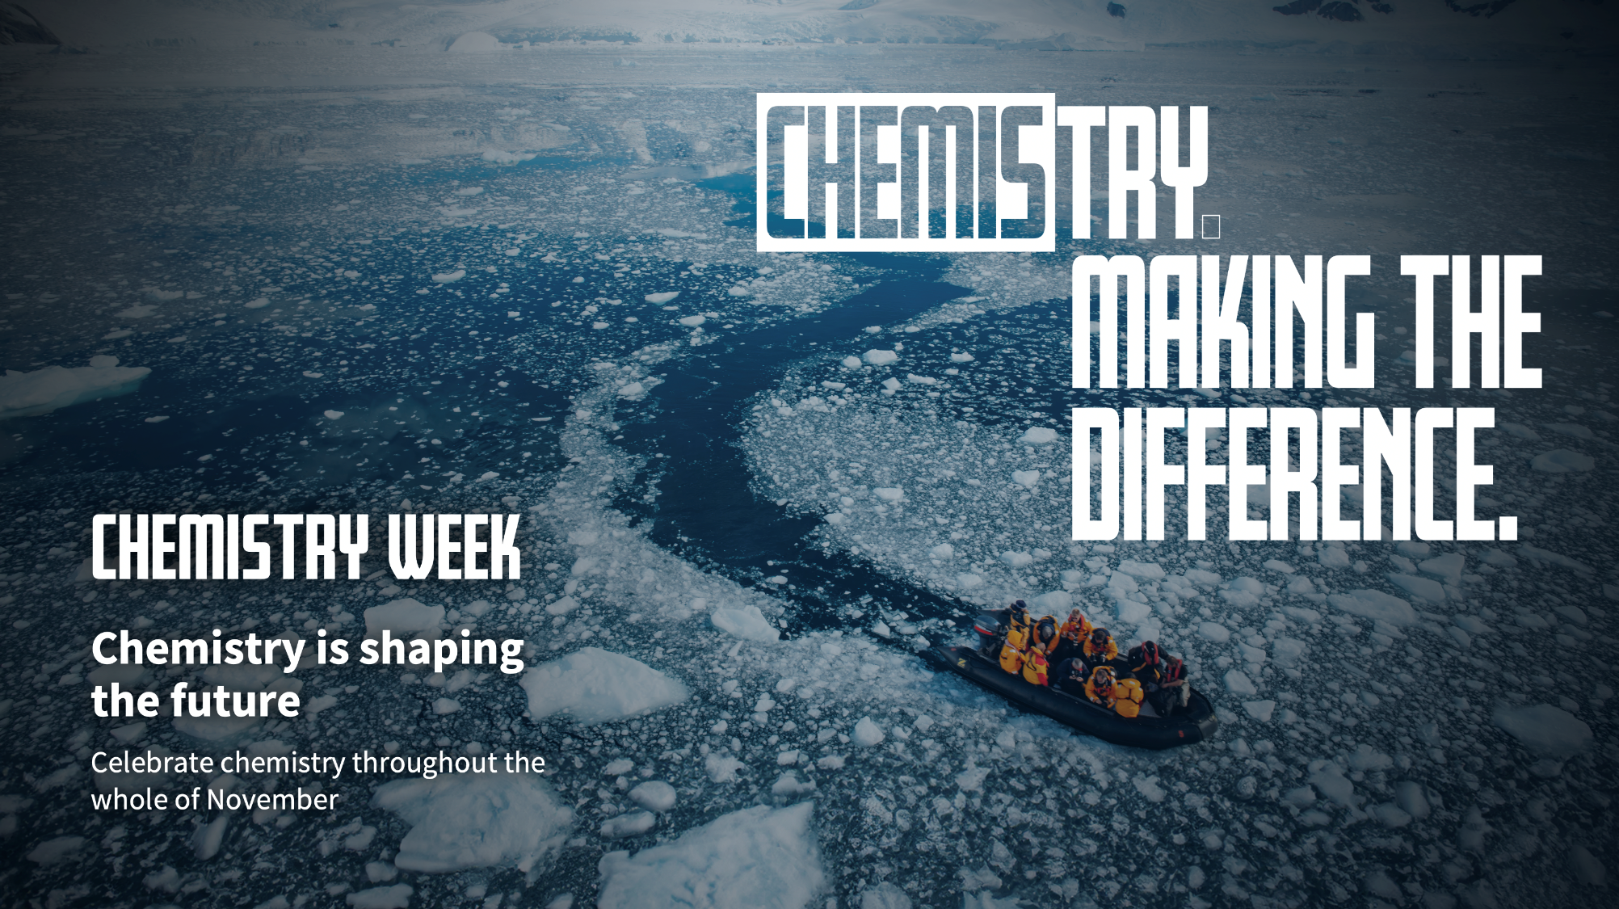

Slide 2
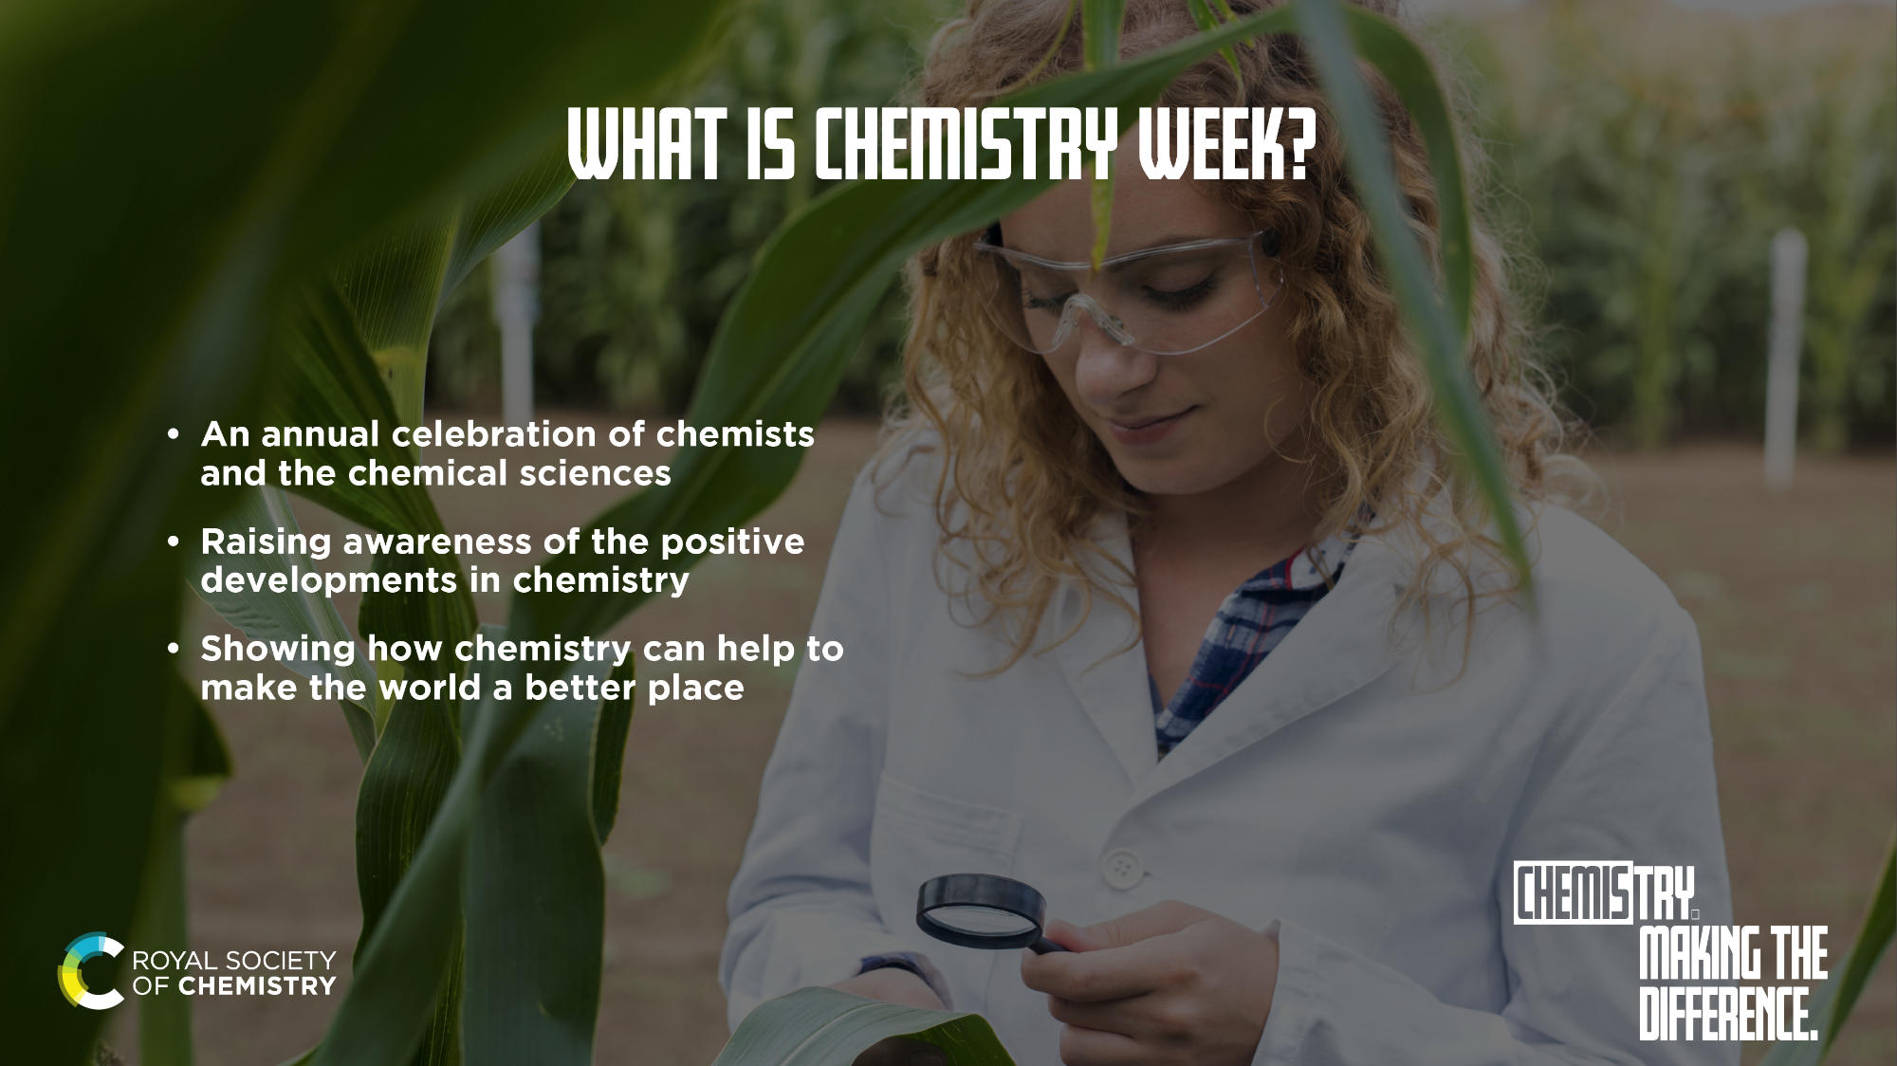
Notes:
Chemistry Week is an annual celebration of chemists and the chemical sciences, and although it’s taking place 4 –10 November, we think the theme of ‘chemistry is shaping the future’ is worthy of a whole month. The Royal Society of Chemistry want all of November to be a celebration of chemistry and the positive impact it has on everyone’s daily lives, right now and in the future.

Slide 3
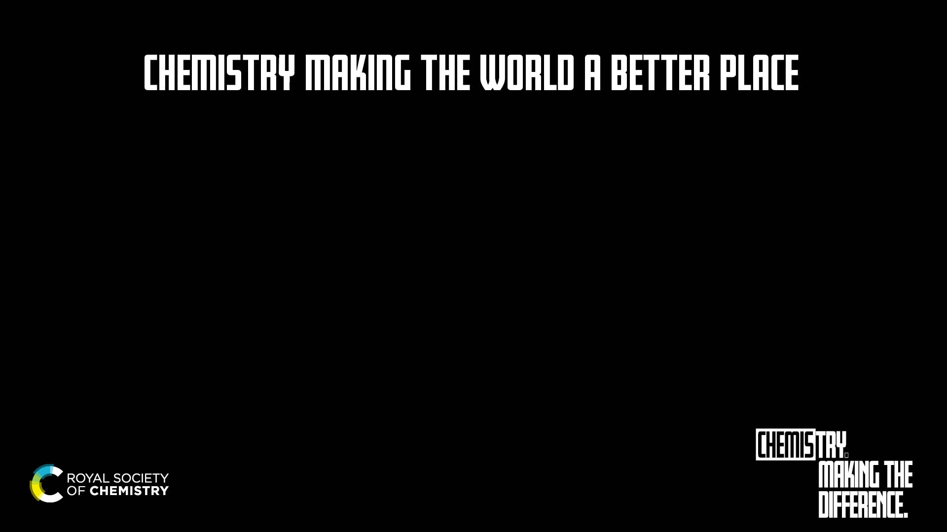

Notes:
Did you know that chemistry is at the heart of everything around us? It is essential to everything we touch, wear and use. It’s crucial in helping us to tackle climate change. It brings us closer to easing the pressures on energy, food and water. And it is our means for developing the life-changing medicines that let us live healthier, happier lives.
This video shows just some of the ways a career in chemistry can fix the future and bring about positive change in the world.
Note: more videos here: https://edu.rsc.org/future-in-chemistry/making-the-difference

Slide 4
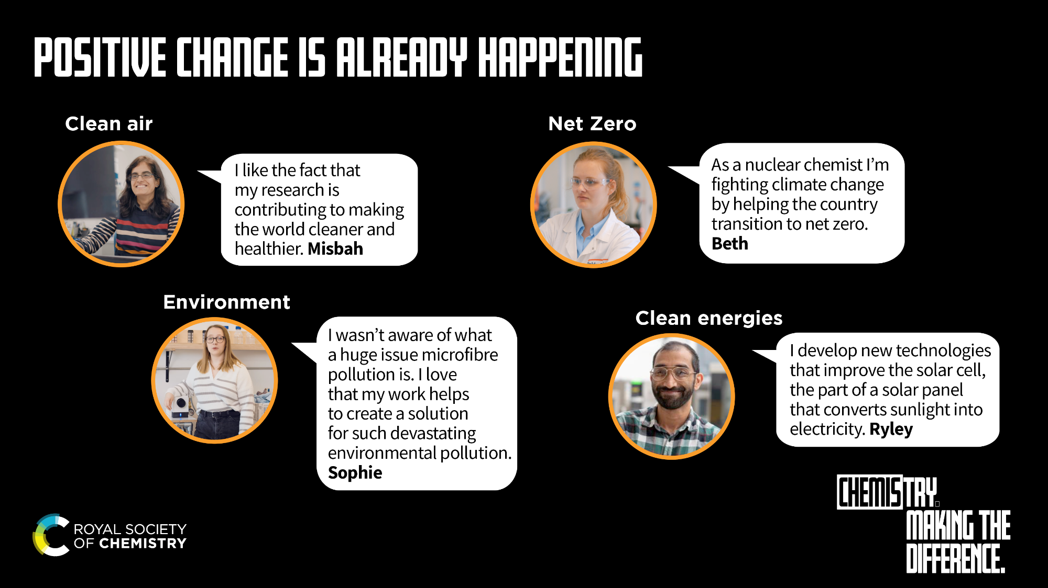
Notes:
The impact of chemistry is incredible. It has led to positive outcomes and developments for the individual up to global society. Chemistry supports development across all aspects of society, including health, climate and the environment, wealth and industry, sustainability, wellbeing, education, justice, equality, nutrition, and alleviation of poverty. Within the chemical sciences there is a rich and diverse community of groups and individuals who, driven by dedication and professionalism, work to make the world a better place.
Misbah https://edu.rsc.org/job-profiles/senior-principal-scientist/4015672.article
Sophie https://edu.rsc.org/job-profiles/research-scientist-microplastics/4019396.article
Ryley https://edu.rsc.org/job-profiles/solar-technology-engineer/4013827.article

Slide 5
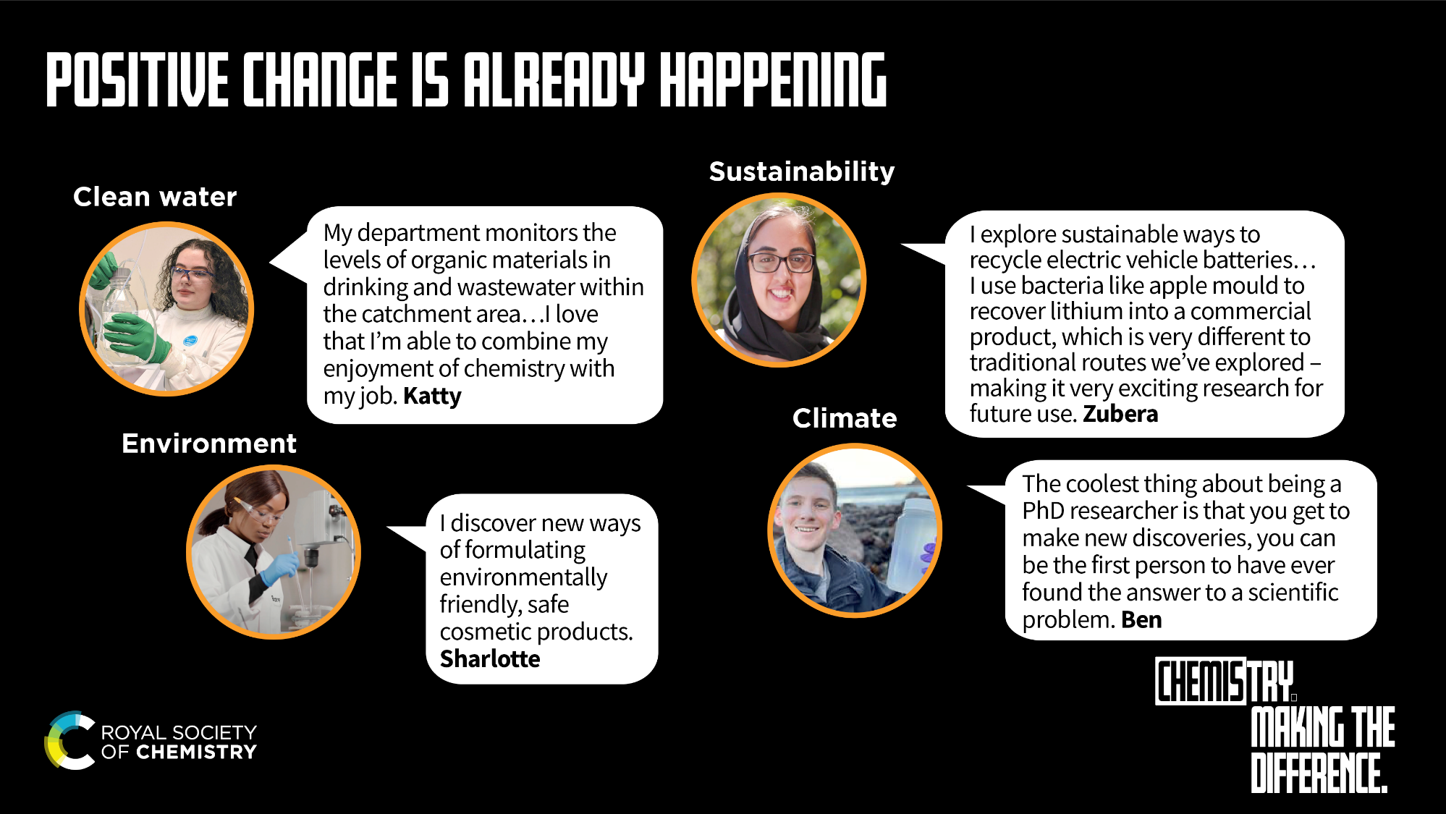
Notes:
The impact of chemistry is incredible. It has led to positive outcomes and developments for the individual up to global society. Chemistry supports development across all aspects of society, including health, climate and the environment, wealth and industry, sustainability, wellbeing, education, justice, equality, nutrition, and alleviation of poverty. Within the chemical sciences there is a rich and diverse community of groups and individuals who, driven by dedication and professionalism, work to make the world a better place.
Zubera https://edu.rsc.org/job-profiles/research-fellow-battery-recycling/4013825.article
Katty https://edu.rsc.org/job-profiles/analyst-higher-apprentice-organic-chemistry/4013064.article
Ben https://edu.rsc.org/future-in-chemistry/making-the-difference/fixing-the-future
Sharlotte https://edu.rsc.org/job-profiles/cosmetics-technical-services-chemist/4019258.article

Slide 6
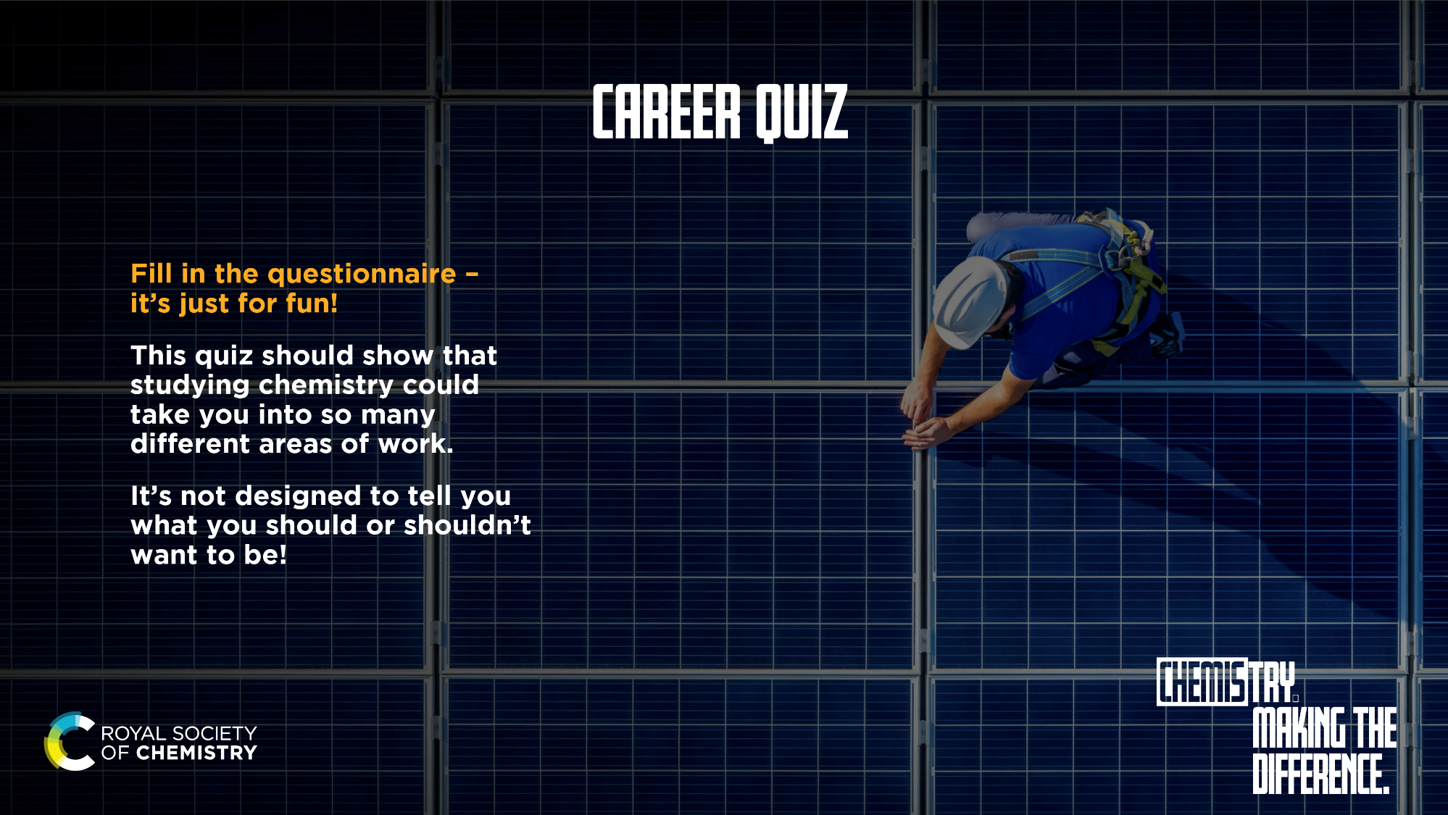
Notes:
https://d1ymz67w5raq8g.cloudfront.net/Uploads/b/l/d/whatcareerquiz_870016.pdf

Slide 7
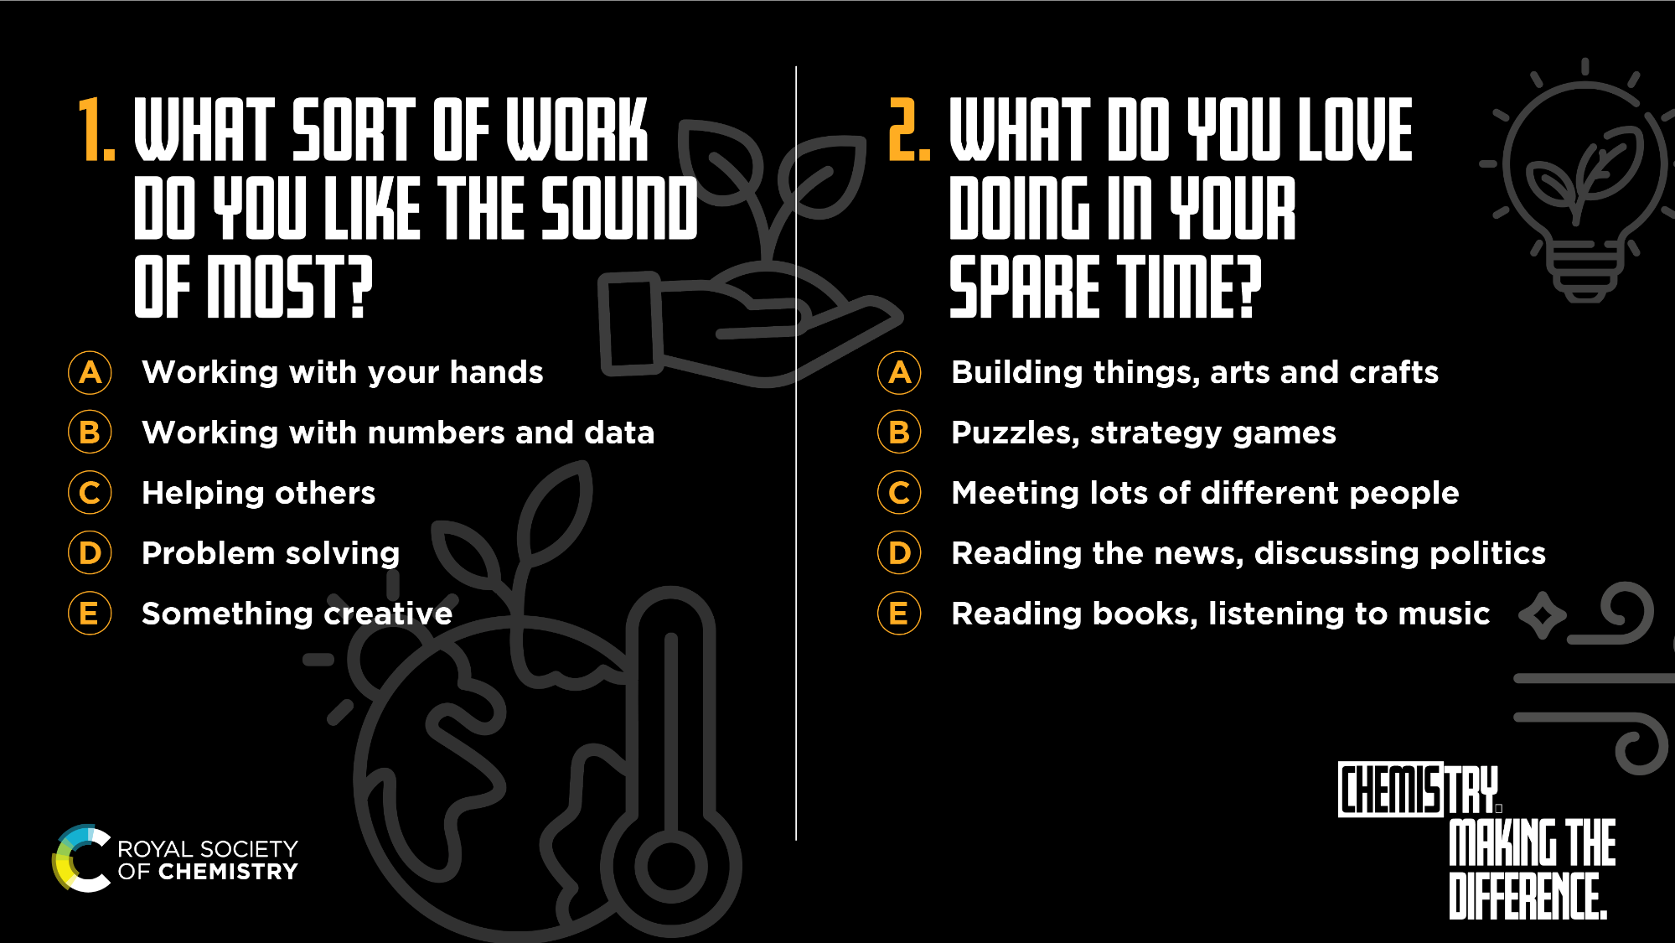

Slide 8
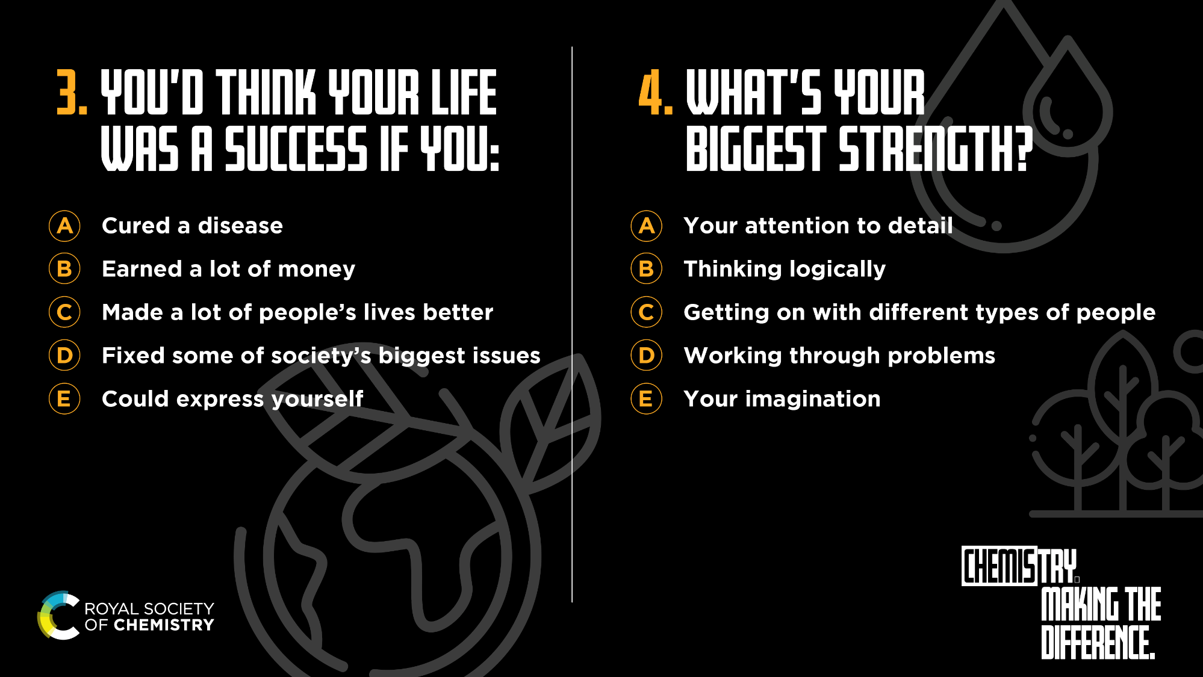

Slide 9
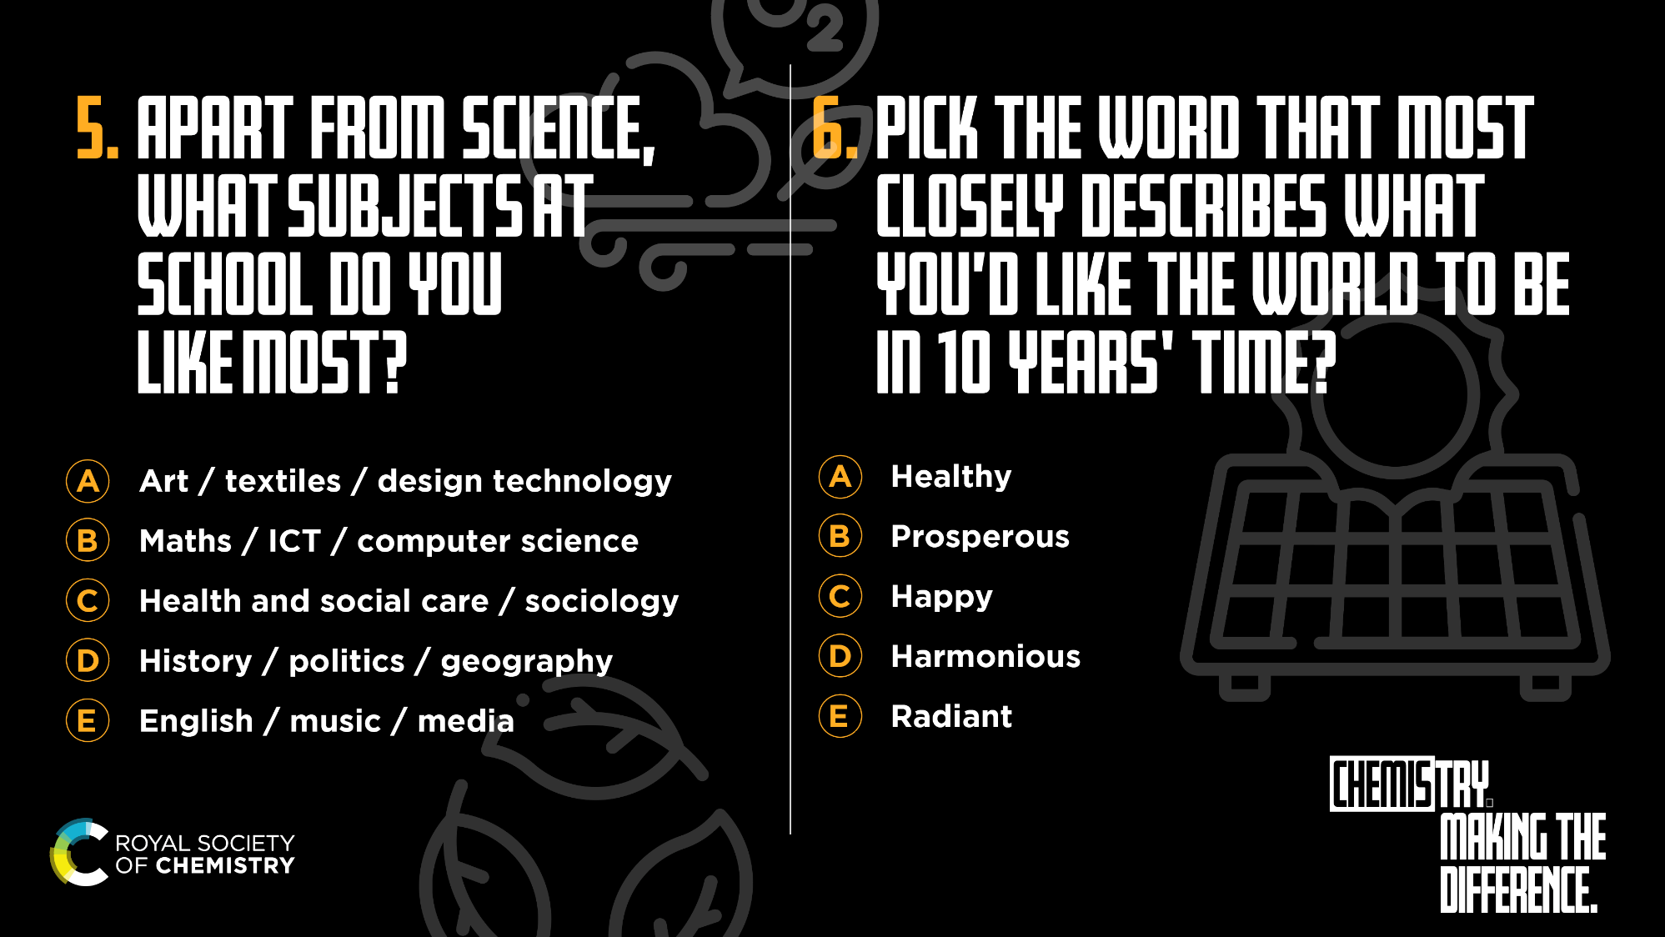

Slide 10
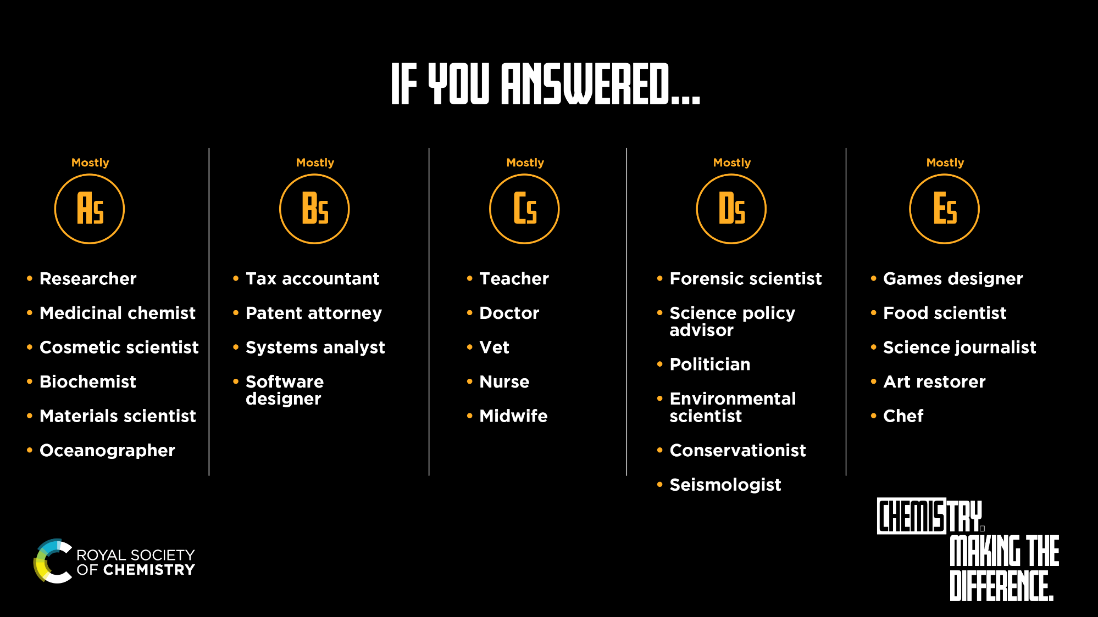

Slide 11
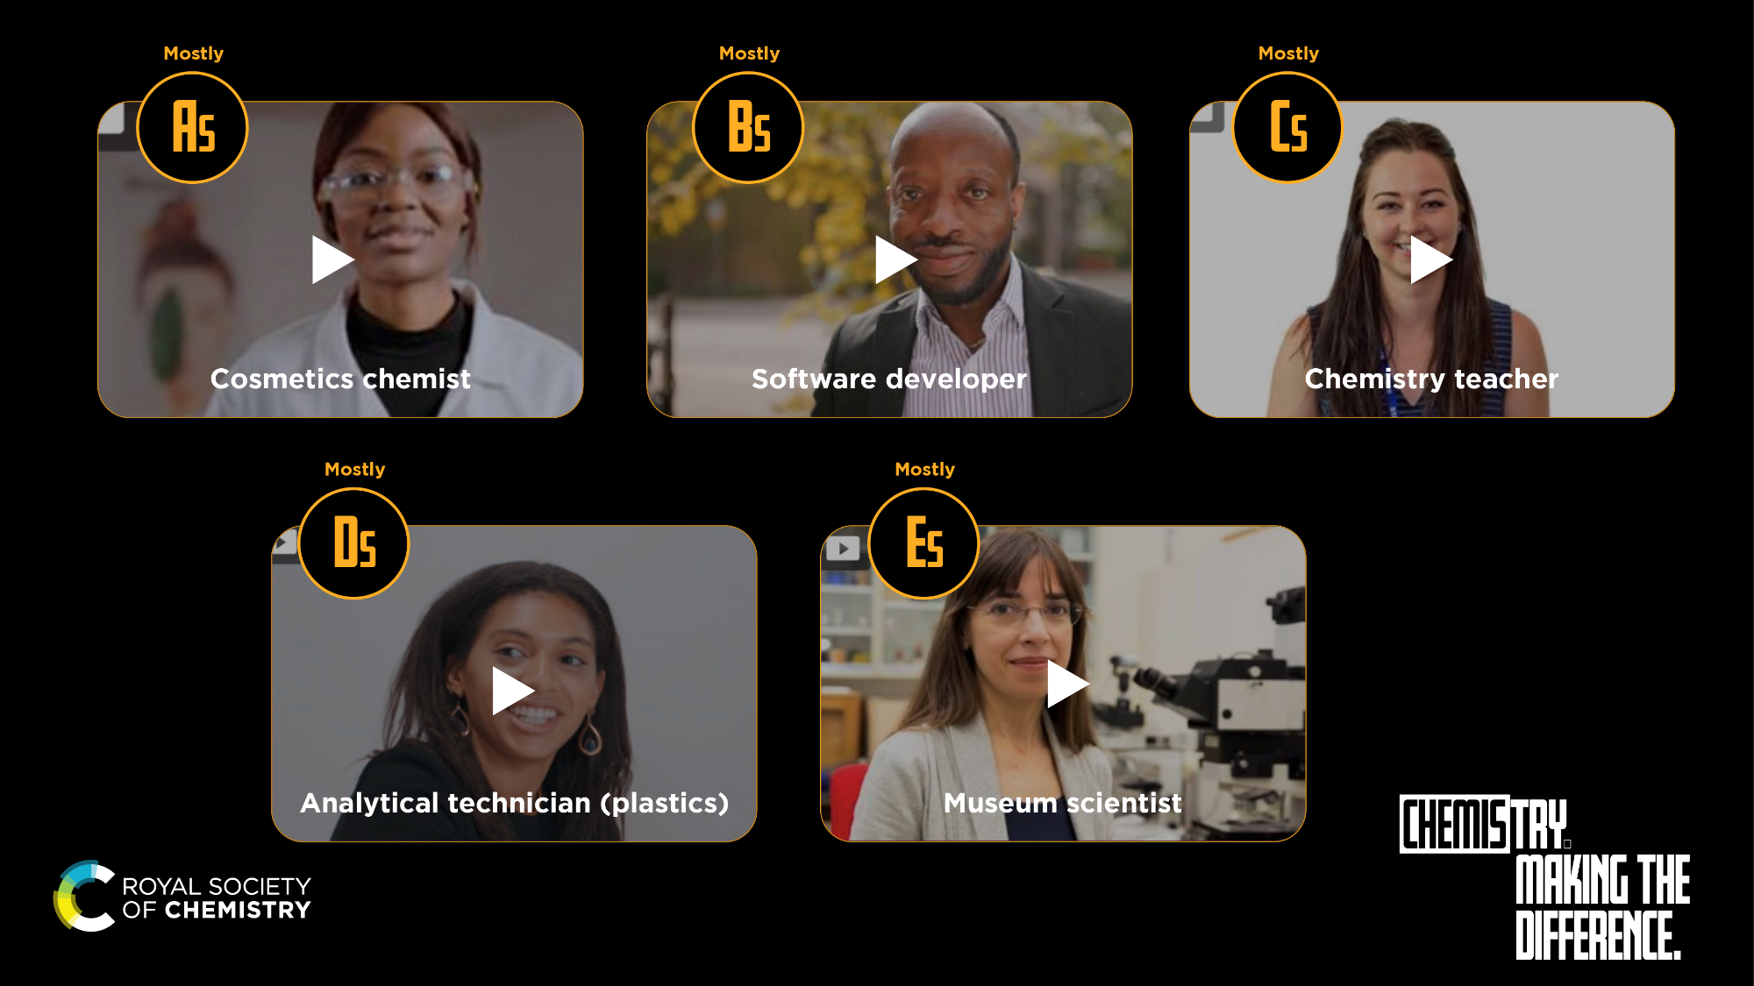
Notes:
A – Cosmetics chemistry (Sharlotte) https://edu.rsc.org/job-profiles/cosmetics-technical-services-chemist/4019258.article
B - Senior Software Developer (Aruna) https://edu.rsc.org/job-profiles/senior-software-developer/4016091.article
C - Teacher (Alice) https://edu.rsc.org/job-profiles/secondary-school-science-teacher/4013147.article
D - Analytical technician (Celine) https://edu.rsc.org/job-profiles/analytical-technician-plastics/4010921.article
E - Museum scientist (Lucia) https://edu.rsc.org/job-profiles/museum-scientist/4013027.article

Slide 12
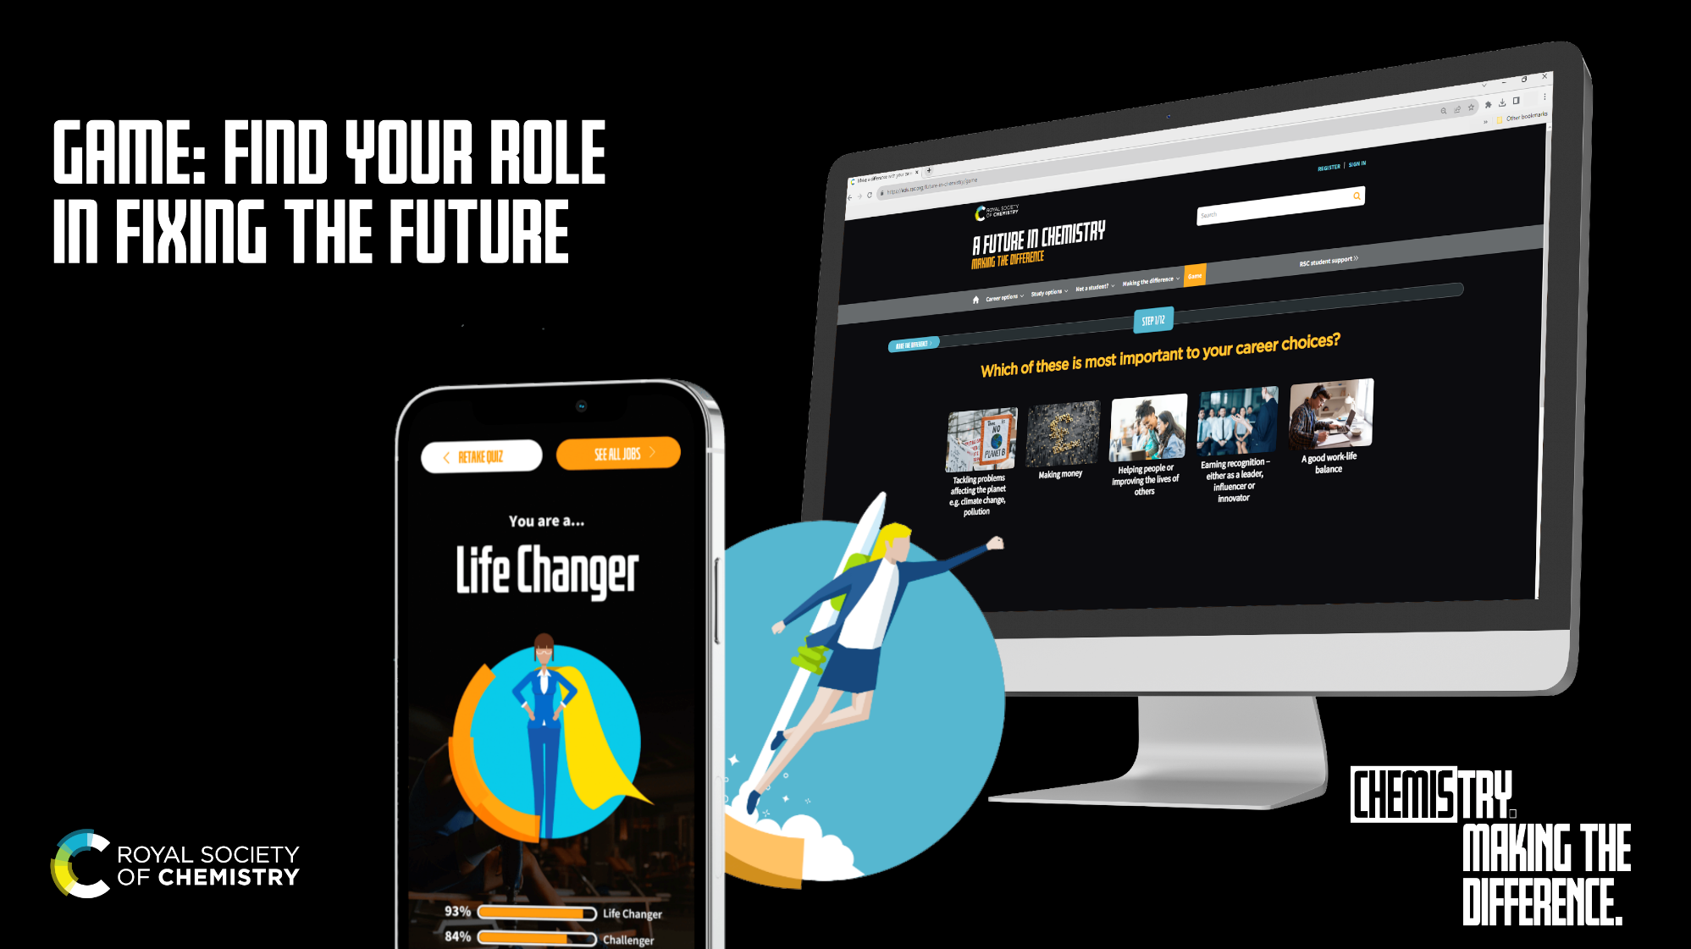
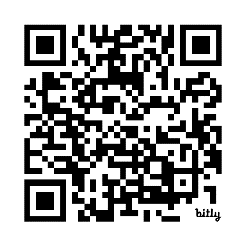
Notes:
Quiz Extension: Your dream job could be in chemistry – you just might not know it yet!
Get more in-depth insights into where a career in chemistry can go with the RSC’s interactive careers game. Solve puzzles and answer questions about your hobbies and interests to discover your hidden talents and famous faces with the same skillset as you. Are you a challenger? A life changer? A catalyst? An innovator? At the end of the game, you’ll be linked to more information about chemistry careers that could help you use your skills to make a difference in the world.
Play game: https://edu.rsc.org/future-in-chemistry/game

Slide 13
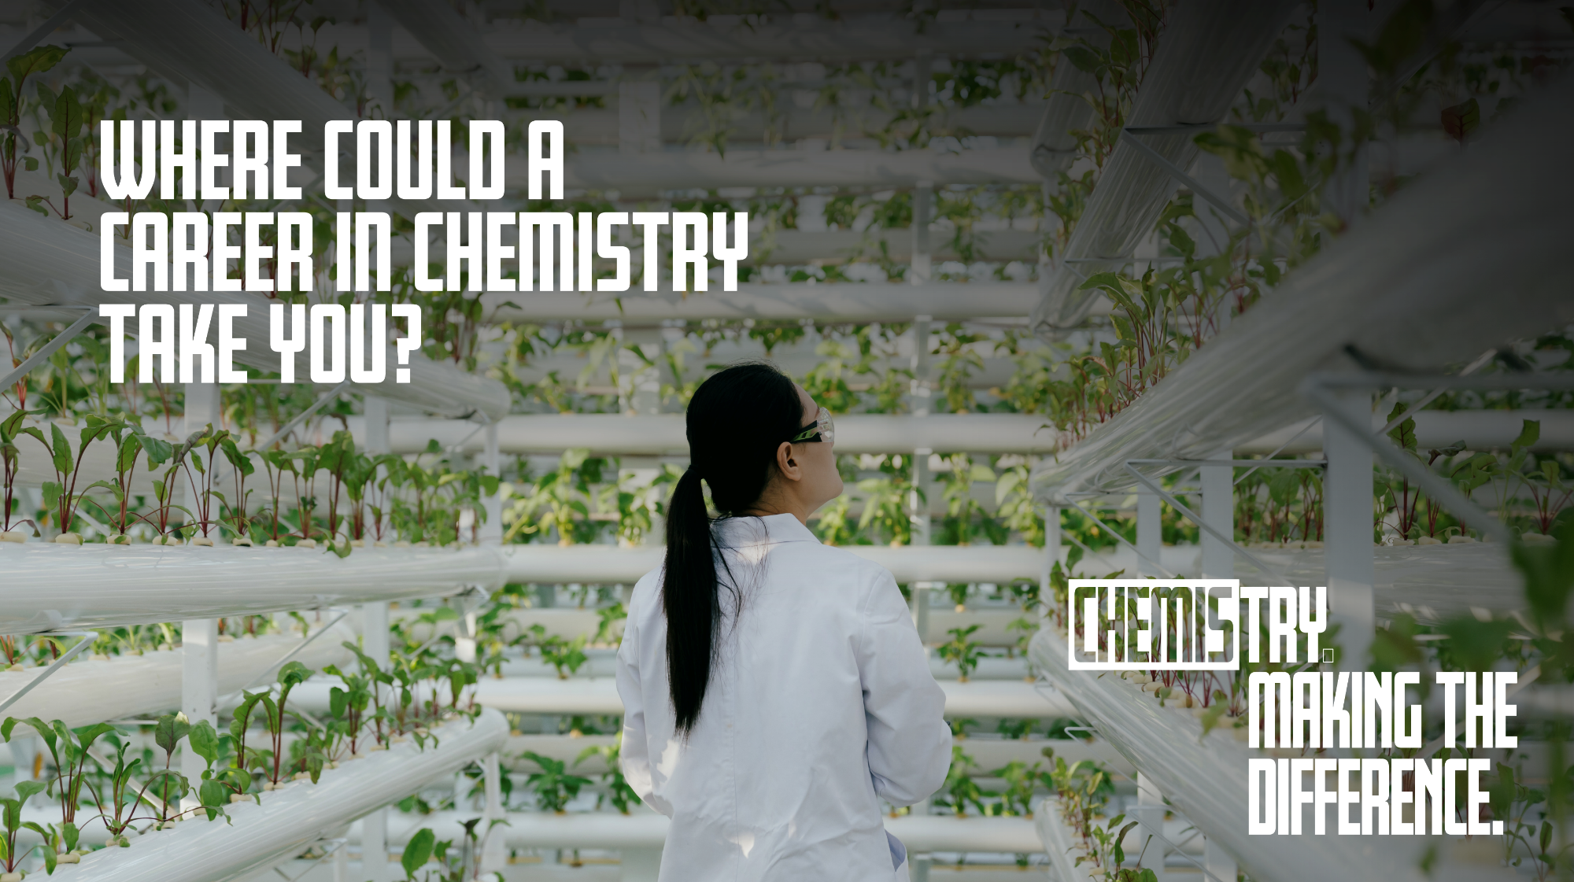
Notes:
Signpost your students to more resources on our A Future in Chemistry pages
​
What jobs can I do? https://edu.rsc.org/future-in-chemistry/career-options/what-jobs-can-i-do
Job Profiles by Qualification​: https://edu.rsc.org/future-in-chemistry/career-options/job-profiles/job-profiles-by-qualification
Job Profiles by Salary ​https://edu.rsc.org/future-in-chemistry/career-options/job-profiles/job-profiles-by-starting-salary
Careers in chemistry A to Z​ https://edu.rsc.org/future-in-chemistry/career-options/job-profiles/careers-in-chemistry-a-to-z
Study options page ​https://edu.rsc.org/future-in-chemistry/study-options
Employers Map – Discover where chemists work https://edu.rsc.org/future-in-chemistry/career-options/work-experience/employers-of-chemical-scientists
Guide to work experience https://edu.rsc.org/future-in-chemistry/career-options/work-experience

